Slide 1

CMR Technical Campus Department of Information Technology
Major Project Stage – II
Final Review
Project Title :
Summarizing legal and financial documents by ranking the sentences using NLP & AI Models
Presented By:​
Batch No: 07
H. No: 227R1A1231 Name: K.Akshaya
H. No: 237R5A1205 Name: D.Nikhil
H. No: 227R1A1226 Name: K.Phanindra
H. No: 217R1A12A6 Name: M.Sathwik
​
Project Supervisor:​
Name:​ K.Srinu
Designation: Assistant Professor

Slide 2
Index
Introduction & Overview
Existing System
Disadvantages
Advantages
Software and hardware requirements
Novelty of the project
Architecture
Models
UML diagrams
Source Code
Results
Conclusion & Future Enhancements
References

Slide 3
INTRODUCTION
​
Legal and financial documents are often lengthy and complex, making manual analysis slow and error-prone. This work presents an intelligent summarization system using advanced NLP and Transformer-based models. The system extracts text from PDFs and applies Sentence-BERT for extractive summarization, identifying key sentences, while BART generates abstractive, human-like summaries.
Performance evaluation using ROUGE metrics, compression ratio, and sentence importance analysis shows improved accuracy and contextual relevance over traditional methods. An interactive web interface enables real-time document upload, summary generation, and visualization, significantly reducing review time, enhancing comprehension, and supporting efficient decision-making. The system is scalable and can be extended for domain-specific and multilingual applications in the future.

Slide 4
Existing System
​
Existing legal and financial document summarization systems mainly rely on traditional NLP and statistical methods, using extractive techniques based on word frequency, TF-IDF, sentence position, or keyword matching. Approaches like rule-based summarization, LSA, and Text Rank help reduce document length but lack semantic understanding, often producing disjointed and non-coherent summaries.
Most tools are domain-independent, failing to capture critical legal or financial information such as obligations, conditions, and key decisions. Additionally, they typically do not provide performance evaluation metrics, visual insights, or interactive interfaces for document upload and analysis. Consequently, professionals like lawyers, financial analysts, and researchers continue to rely on manual reading, which is time-consuming, prone to errors, and limits efficiency.

Slide 5
Disadvantages
​
Relies mainly on keyword-based and statistical extractive methods.
Lacks semantic and contextual understanding of legal and financial text.
Produces non-coherent summaries by copying sentences directly.
May miss critical legal clauses and financial obligations.
Cannot generate human-like abstractive summaries.
Not domain-specific, leading to poor handling of complex terminology.
No evaluation metrics to measure summary accuracy.
Limited user interaction and visualization support.

Slide 6
Proposed System
​The proposed system, Legal and Financial Document Summarizer using NLP and AI Models, is designed to overcome the limitations of traditional summarization methods by using advanced Natural Language Processing (NLP) and Transformer-based deep learning models. The system performs extractive summarization using Sentence-BERT, which ranks sentences based on semantic similarity and contextual importance.
In addition, the system applies abstractive summarization using the BART Transformer model to generate coherent and human-like summaries while preserving the original meaning of the document. The system supports automatic PDF upload and text extraction, making it easy to process large legal and financial documents.
It also provides visual analytics such as sentence importance ranking, text compression comparison, and ROUGE evaluation metrics to measure summary quality. A user-friendly web interface allows users to view summaries and download structured PDF reports, helping legal professionals and financial analysts save time and improve productivity.

Slide 7
Advantages
​
Generates both extractive and abstractive summaries, improving clarity and readability.
Uses advanced NLP and Transformer-based models for accurate and context-aware summarization.
Preserves important legal clauses and financial insights without information loss.
Provides ROUGE evaluation metrics to measure summary accuracy and performance.
Offers visual analytics such as sentence importance and compression comparison.
Supports automatic PDF upload and text extraction, reducing manual effort.
Includes a user-friendly web interface for easy interaction and report download.
Scalable for future enhancements like multilingual and domain-specific summarization.

Slide 8
Hardware & Software Requirements
SOFTWARE REQUIREMENTS
Operating System : Windows 10 / Windows 11 / Linux
Programming Language : Python 3.8 or above
Front-End : Streamlit
Back-End : Python
Libraries & Frameworks :
NLP: NLTK, Sentence-Transformers
Deep Learning: Hugging Face Transformers (BART)
PDF Processing: PyMuPDF (fitz), FPDF
Data Handling: NumPy, Pandas
Visualization: Matplotlib, Seaborn
Development Environment : VS Code / PyCharm / Jupyter Notebook
HARDWARE REQUIREMENTS
Processor : Intel i5 / AMD Ryzen 5 or higher
RAM : Minimum 8 GB (16 GB recommended for faster processing)
Hard Disk : Minimum 20 GB free space

Slide 9
NOVELTY
The novelty of this project lies in combining extractive and abstractive summarization specifically for legal and financial documents using advanced NLP and Transformer-based models. Sentence-BERT captures semantic similarity to rank sentences by contextual importance, while BART generates coherent, human-like summaries that preserve the meaning of complex clauses and financial statements.
The system provides visual analytics, including sentence importance ranking, compression comparison, and ROUGE evaluation metrics, enabling users to assess summary quality and accuracy. A user-friendly web interface allows PDF uploads, real-time summary generation, result analysis, and structured report downloads.
By integrating context-aware summarization, performance evaluation, and interactive visualization, this system offers a more accurate, efficient, and practical solution than existing document summarization tools. It is also scalable for domain-specific and multilingual applications in the future.

Slide 10
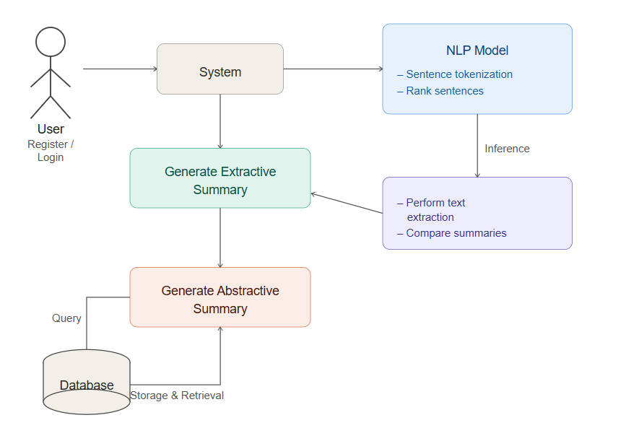
Architecture​

Slide 11
MODULES
1. Document Upload and Text Extraction Module
Allows users to upload PDF documents and extracts readable text for processing.
2. Extractive Summarization Module
Identifies and ranks important sentences using NLP and Sentence-BERT embeddings.
3. Abstractive Summarization Module
Generates concise, human-like summaries using the BART Transformer model.
4. Visualization and Analytics Module
Displays sentence importance, compression ratio, and ROUGE evaluation metrics.
5. PDF Report Generation Module
Creates downloadable PDF reports containing summarized results.
6. User Interface Module
Provides a simple and interactive web interface for user interaction

Slide 12
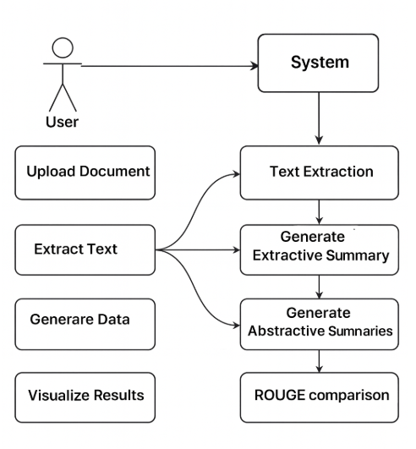
UML Diagrams​
USE CASE DIAGRAM

Slide 13
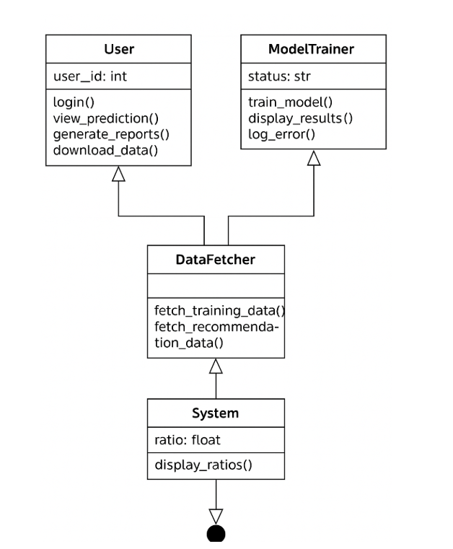
UML Diagrams​
CLASS DIAGRAM

Slide 14
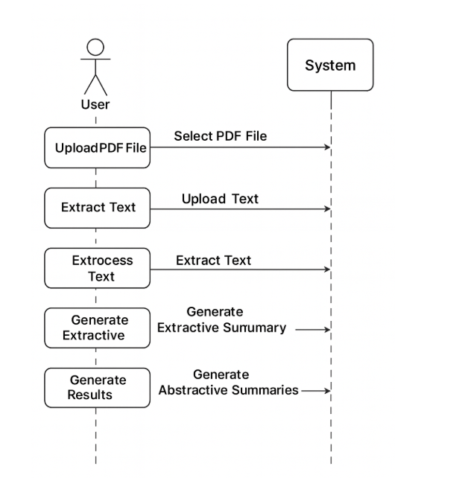
UML Diagrams
SEQUENCE DIAGRAM

Slide 15
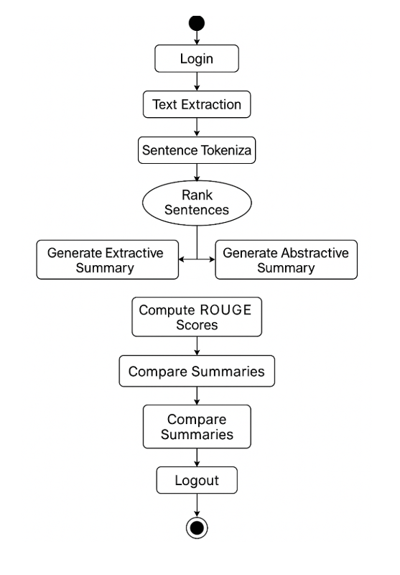
UML Diagrams
FLOWCHART DIAGRAM

Slide 16
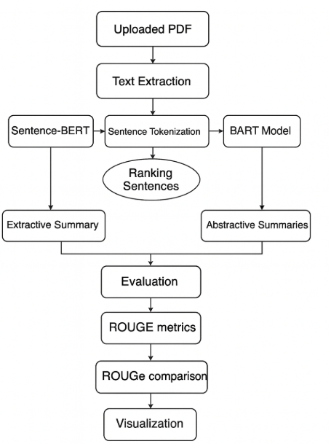
UML Diagrams
DATAFLOW DIAGRAM

Slide 17
Source Code
import streamlit as st
import pandas as pd
import os
import fitz
import nltk
import torch
import matplotlib.pyplot as plt
import seaborn as sns
import re
import numpy as np
from nltk.tokenize import sent_tokenize
from sentence_transformers import SentenceTransformer, util
from rouge_score import rouge_scorer
from fpdf import FPDF
import hashlib # ✅ for password hashing
st.set_page_config(page_title="Legal & Financial Document Summarizer", layout="wide")
nltk.download('punkt', quiet=True)
nltk.download('punkt_tab', quiet=True)

Slide 18
Source Code
BASE_DIR = os.path.dirname(os.path.abspath(__file__))
USERS_FILE = os.path.join(BASE_DIR, "users.csv")
def hash_password(password):
"""Encrypt password using SHA256 (secure & simple)."""
return hashlib.sha256(password.encode()).hexdigest()
def verify_password(input_password, stored_password_hash):
"""Check if user-entered password matches stored hash."""
return hash_password(input_password) == stored_password_hash
# Create users.csv if not exists
if not os.path.exists(USERS_FILE):
df = pd.DataFrame(columns=["username", "password"])
df.to_csv(USERS_FILE, index=False)
st.info(f"🆕 Creating user database at: {USERS_FILE}")
def user_exists(username):
users = pd.read_csv(USERS_FILE)
return username in users["username"].values
def add_user(username, password):
users = pd.read_csv(USERS_FILE)
new_user = pd.DataFrame([[username, hash_password(password)]], columns=["username", "password"])
users = pd.concat([users, new_user], ignore_index=True)

Slide 19
Source Code
f "logged_in" not in st.session_state:
st.session_state.logged_in = False
menu = ["Login", "Sign Up"]
choice = st.sidebar.selectbox("Navigation", menu)
if not st.session_state.logged_in:
if choice == "Login":
st.title("🔐 Login to Legal & Financial Document Summarizer")
username = st.text_input("👤 Username")
password = st.text_input("🔑 Password", type="password")
if st.button("Login"):
if verify_user(username, password):
st.session_state.logged_in = True
st.download_button(
"⬇️ Download Report (PDF)",
data=pdf_bytes,
file_name="Legal_Summary_Report.pdf",
mime="application/pdf"
)
else:
st.warning("⚠️ Please upload and summarize a document first before downloading the report.")

Slide 20
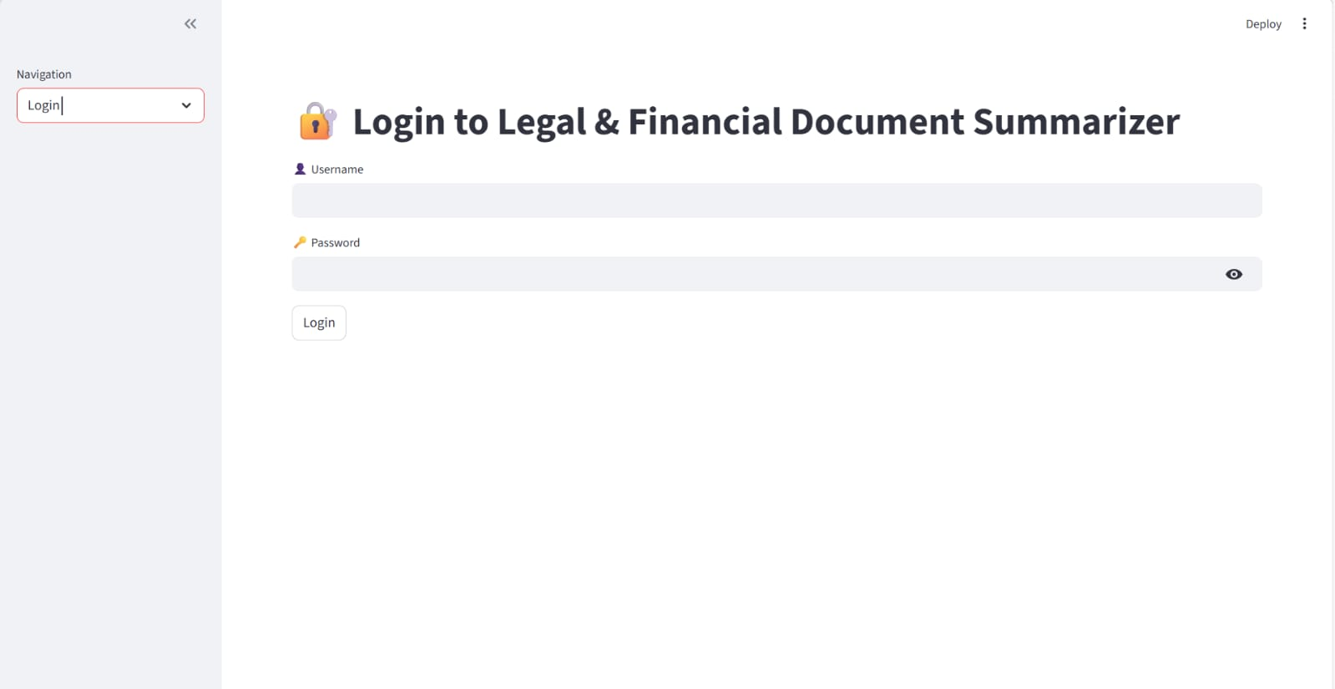
RESULTS​
This interface allows users to securely log in using their username and password. It ensures authorized access to the document summarization system..

Slide 21
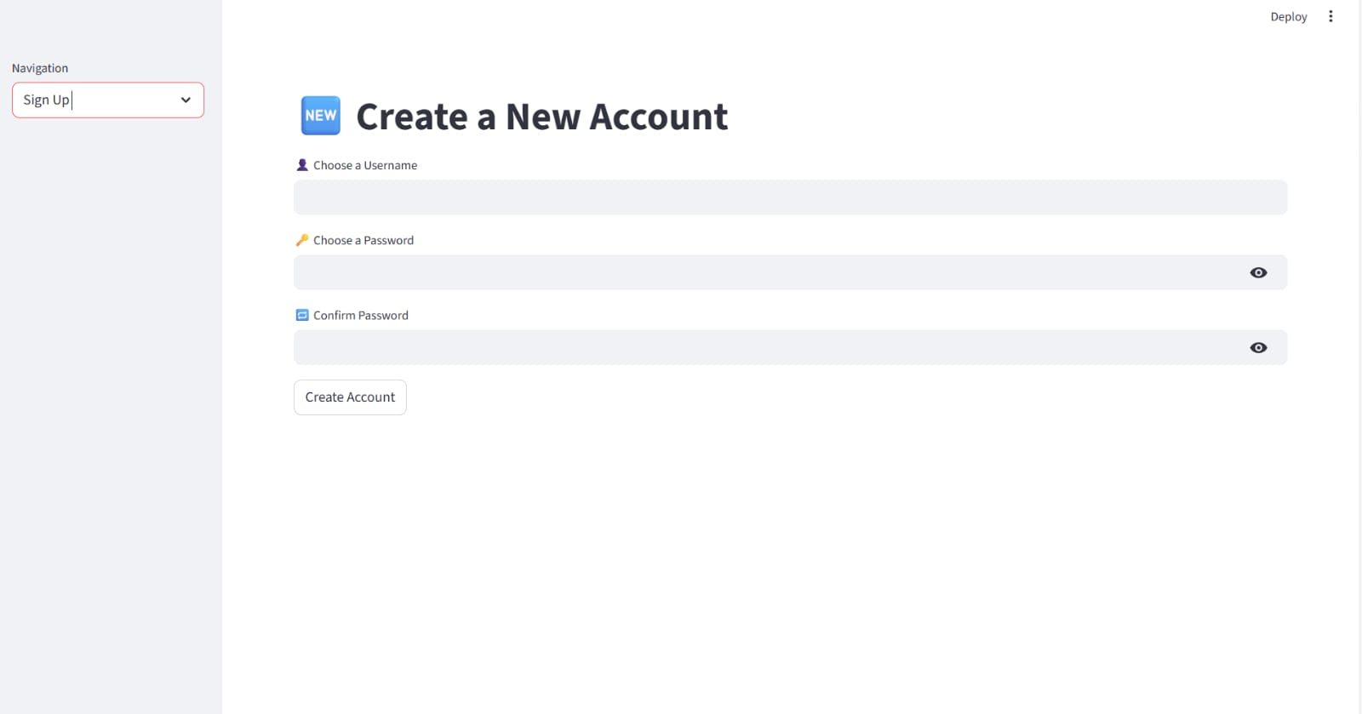
RESULTS​
This interface enables new users to create an account by entering required details. It ensures secure registration and access to system features.

Slide 22
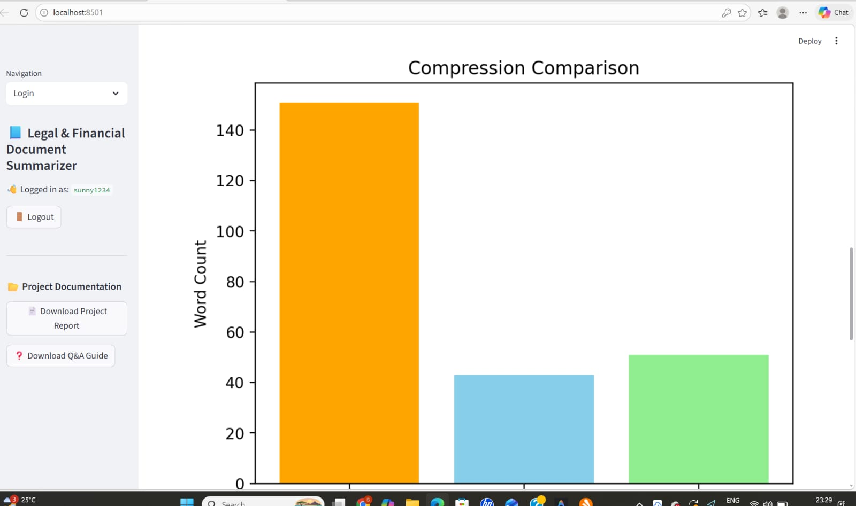
RESULTS​
This graph shows the reduction in word count between the original document and generated summaries. It highlights the efficiency of summarization techniques.

Slide 23
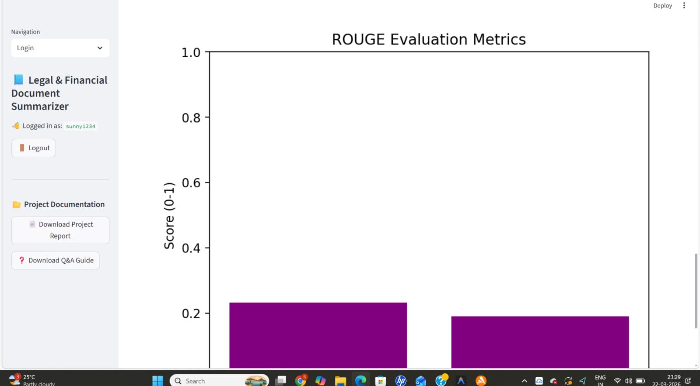
RESULTS​
This graph evaluates the quality of generated summaries using ROUGE scores. It measures how closely the summary matches the original content.

Slide 24
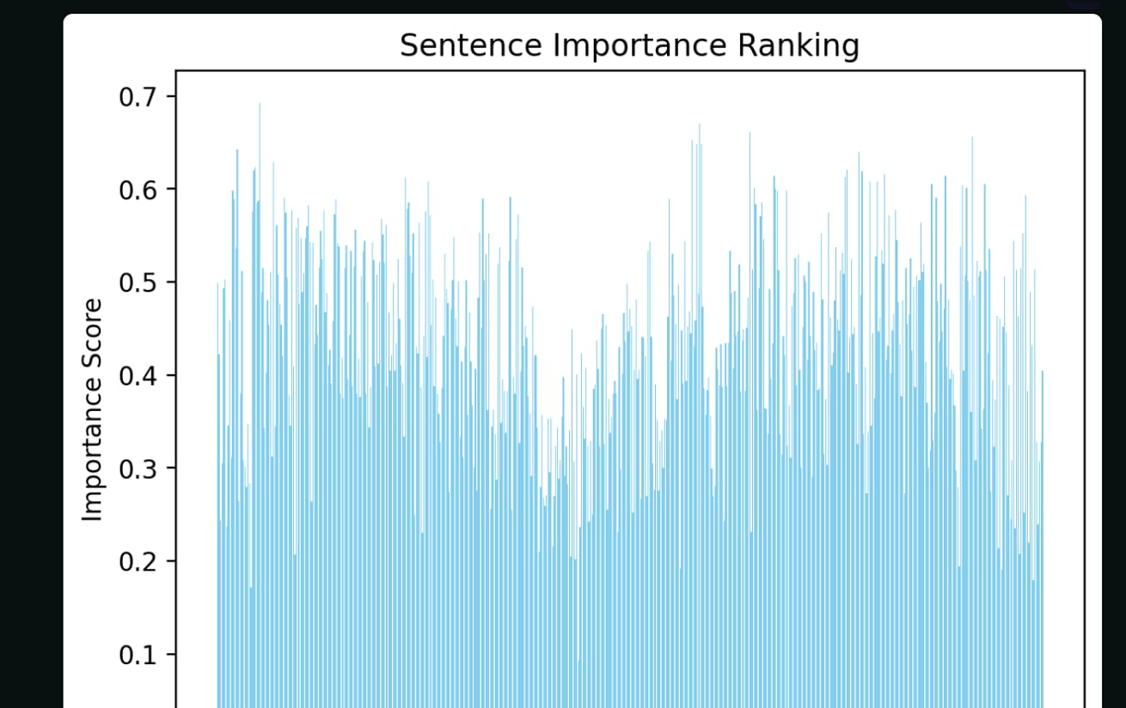
RESULTS​
This graph displays the importance score of each sentence in the document. Higher scores indicate sentences selected for extractive summarization.

Slide 25
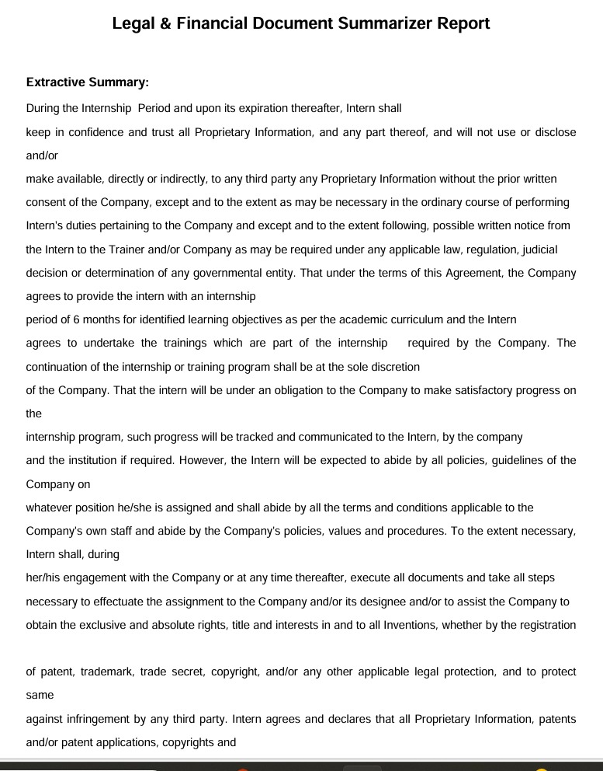
RESULTS​
This output shows key sentences directly extracted from the original document. It helps users quickly understand important information.

Slide 26
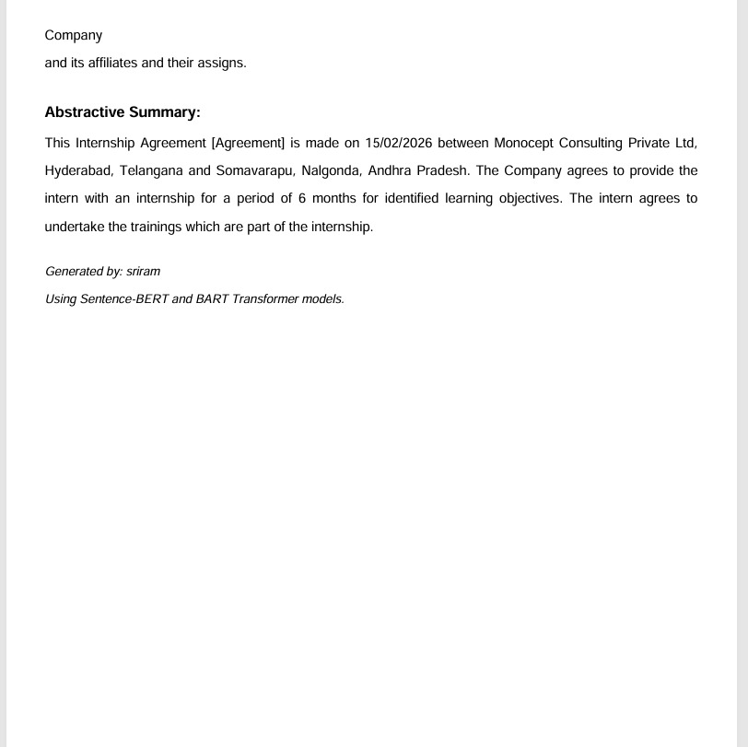
RESULTS​
This output presents a rephrased summary generated using AI models. It provides a concise and human-like understanding of the document.

Slide 27
Conclusion & Future Enhancement
The Legal & Financial Document Summarizer represents a significant step forward in automated document analysis. By successfully combining the precision of extractive methods with the fluency of generative AI, the system offers a comprehensive tool for professionals. The project demonstrates not only the capability of modern Transformers but also the practical application of these complex models in solving real-world efficiency problems. The resulting application is robust, user-friendly, and ready for deployment in small-to-medium enterprise environments.

Slide 28
GitHub link
https://github.com/NikhilDosala/MAJOR-PROJECT

Slide 29
THANK YOU

